Slide 1


<Name>
<Date>

Slide 2

Outline
Executive Summary
Introduction
Methodology
Results
Conclusion
Appendix

Slide 3
Executive Summary
This project aims to predict the successful landing of the Falcon 9 rocket’s first stage using various classification algorithms, including Logistic Regression, Support Vector Machine, Decision Tree, and K-Nearest Neighbors.
Globally, all algorithms achieved similar accuracy scores. In certain execution, Decision Tree accuracy change and can gives us a better score.

Slide 4
Introduction
Falcon 9 rocket launches cost approximatively 165 million dollars each, however SpaceX can reuse the first stage of the rocket, therefore they can save 100 million dollars for each.
We want to predict the if the Falcon 9 first stage will land successfully to get a price of each launches.

Slide 5

Section 1

Slide 6
Methodology
Executive Summary
Data collection methodology:
The data is collected from this API : https://cf-courses-data.s3.us.cloud-object-storage.appdomain.cloud/IBM-DS0321EN-SkillsNetwork/datasets/API_call_spacex_api.json.
Perform data wrangling
On the column “Outcome” 1 means the booster successfully landed 0 means it was unsuccessful.
Perform exploratory data analysis (EDA) using visualization and SQL
Perform interactive visual analytics using Folium and Plotly Dash
Perform predictive analysis using classification models
Split data to training and testing sets, use the GridSearchCV to tune and we compare the different classification method by using the “accuracy” metrics.

Slide 7
Data Collection
We collected the data from this API : “https://cf-courses-data.s3.us.cloud-object-storage.appdomain.cloud/IBM-DS0321EN-SkillsNetwork/datasets/API_call_spacex_api.json”
After collecting SpaceX launch data, we filtered to include only “Falcon 9” launches then we cleaned the data.

Slide 8
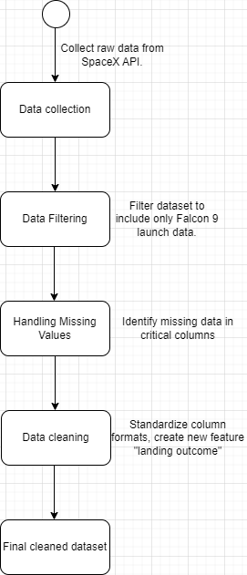
Data Collection – SpaceX API
We used SpaceX's REST API to collect launch data, focusing specifically on Falcon 9 missions. The process involved making API calls, filtering for relevant data, handling missing values, and storing the cleaned data for further analysis. A flowchart was created to illustrate the steps from API requests to data preparation.
GitHub repository:
https://github.com/Phil1010/FP/tree/main/module1

Slide 9
Data Collection - Scraping
We scrapped data for booster version, site, payload and core from different URL
Git repo : https://github.com/Phil1010/FP/blob/main/module1/jupyter-labs-spacex-data-collection-api.ipynb

Slide 10
Data Wrangling
Count launches on each site, count the “Outcome” (how many “True ASDS”, “NONE NONE”, …), assign 0 for bad_outcome, 1 otherwise
Git repo : https://github.com/Phil1010/FP/blob/main/module1/labs-jupyter-spacex-Data%20wrangling.ipynb

Slide 11
EDA with Data Visualization
Scatter plot for :
flight number vs payload mass
flight number vs launch site
payload vs launch site
flight number vs orbit type
payload vs orbit type
=> Payload mass between 0 and 6k, site launch most CCAFS SLC 40>KSC LC 39A>VAFB SLC 4E
Bar plot for :
success rate vs orbit type => insight, SSO, HEO, GEO and ES-L1 gives us a very good result unlike SO
Linear plot for :
success vs year => success rate increase over the years
Git repo : https://github.com/Phil1010/FP/tree/main/module2

Slide 12
EDA with SQL
cur.execute("SELECT DISTINCT Launch_Site FROM SPACEXTABLE;")
launch_sites_cca = cur.execute("SELECT * FROM SPACEXTABLE WHERE Launch_Site LIKE 'CCA%' LIMIT 5;" )
cur.execute("SELECT SUM(PAYLOAD_MASS__KG_) FROM SPACEXTABLE WHERE CUSTOMER = 'NASA (CRS)';")
…
cur.execute("SELECT Landing_Outcome, COUNT(*) AS Count FROM SPACEXTABLE WHERE Date BETWEEN '2010-06-04' AND '2017-03-20' GROUP BY Landing_Outcome ORDER BY Count DESC;")
Git repo : https://github.com/Phil1010/FP/tree/main/module2

Slide 13
Build an Interactive Map with Folium
Markers : launches site, circles : number of launches, color :green => success / red => fail
Users have to get a global idea on the first look
Git repo : https://github.com/Phil1010/FP/tree/main/module3

Slide 14
Build a Dashboard with Plotly Dash
Interactive pie chart to see the proportion of each sites, a dropdown to select a launch site to see the proportion of success rate. Finally, the scatter plot of the success rate over the payload mass, we have a slider to limit the value of the payload.
Pie chart => quick view of different proportion, scatter plot => the correlation of variables. The dropdown => see the success rate of each sites, slider => focus on the mass.
Git repo : https://github.com/Phil1010/FP/tree/main/module3

Slide 15
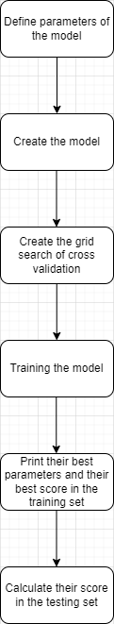
Predictive Analysis (Classification)
Split data set into 2 different set, training set and testing set, using cross-validation protocol, training different model of classification algorithm and finally compare their accuracy score.
Git repo : https://github.com/Phil1010/FP/tree/main/module4

Slide 16
Results
Exploratory data analysis results :
Payload mass and success rate
Success rate over years
Predictive analysis results :
Logistic regression : 0.8464285714285713
SVM : 0.8482142857142856
Decision tree : 0.8892857142857145
KNN : 0.8482142857142858

Slide 17

Section 2

Slide 18
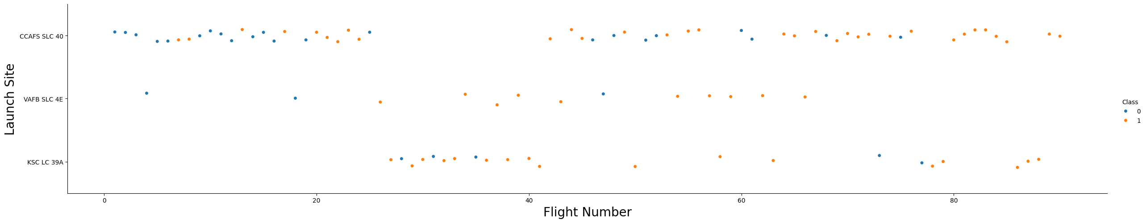
Flight Number vs. Launch Site
CCAFS SLC 40 is the oldest launch site, VAFB SLC 4E and KSC LC 39A have a good success rate

Slide 19
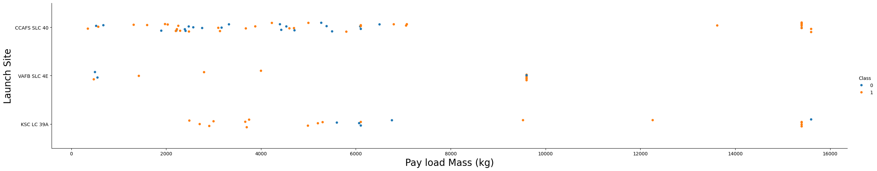
Payload vs. Launch Site
The range of the payload mass is between 0 and 8K kg.

Slide 20
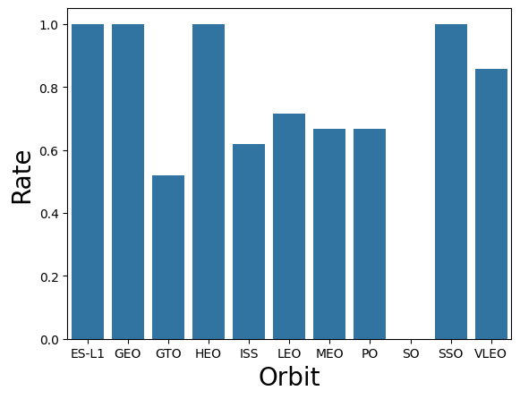
Success Rate vs. Orbit Type
ES-L1, GEO, HEO, SSO are a very good choice, unlike SO.

Slide 21
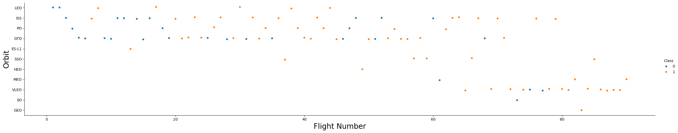
Flight Number vs. Orbit Type
LEO, ISS, VLEO gives us frequently good results

Slide 22
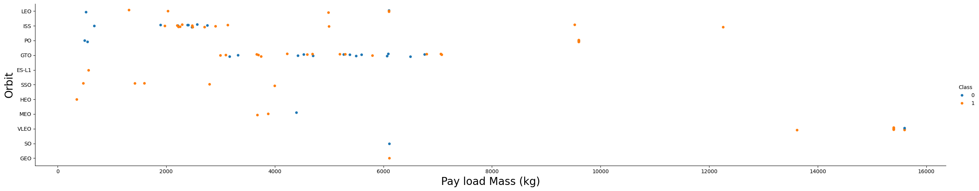
Payload vs. Orbit Type
The range of the payload mass is between 0 and 8K kg, except for the orbit VLEO which is between 13K and 16K kg.

Slide 23
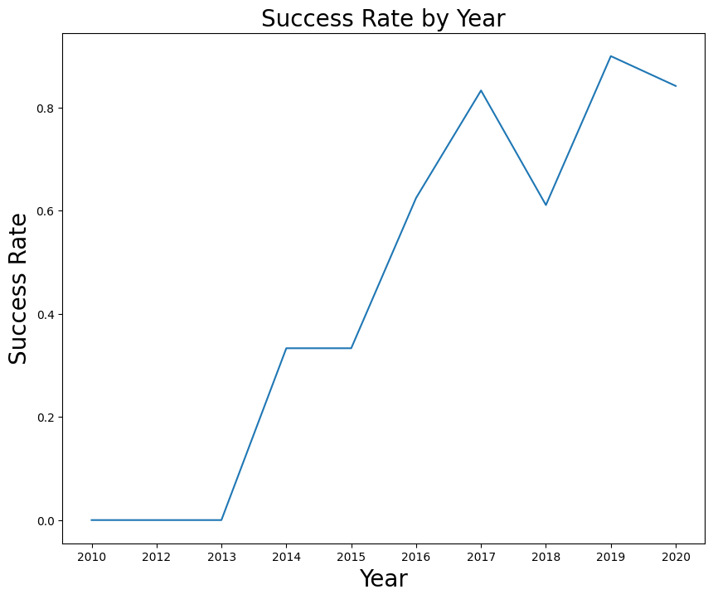
Launch Success Yearly Trend
As we can see the success rate increase over the year, due to the upgrade of the technique.

Slide 24
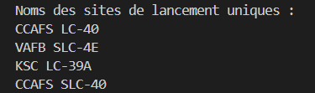
All Launch Site Names
SELECT DISTINCT Launch_Site FROM SPACEXTABLE;
4 unique launch site in the database.

Slide 25
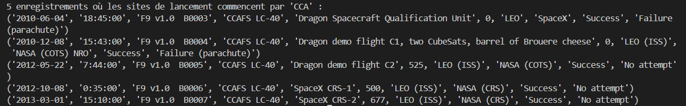
Launch Site Names Begin with 'CCA'
Find 5 records where launch sites begin with `CCA` querie : SELECT * FROM SPACEXTABLE WHERE Launch_Site LIKE 'CCA%' LIMIT 5;
Result :

Slide 26
Total Payload Mass
Calculate the total payload carried by boosters from NASA querie : SELECT SUM(PAYLOAD_MASS__KG_) FROM SPACEXTABLE WHERE CUSTOMER = 'NASA (CRS)’;
Result : 45596 kg

Slide 27
Average Payload Mass by F9 v1.1
Calculate the average payload mass carried by booster version F9 v1.1querie : SELECT AVG(PAYLOAD_MASS__KG_) FROM SPACEXTABLE WHERE BOOSTER_VERSION = 'F9 v1.1’;
Result : 2928.4 kg

Slide 28
First Successful Ground Landing Date
Find the dates of the first successful landing outcome on ground pad querie : SELECT MIN(DATE) FROM SPACEXTABLE WHERE Landing_Outcome = 'Success (ground pad)’;
Result : 2015-12-22

Slide 29
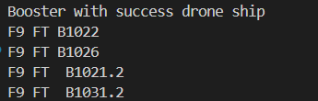
Successful Drone Ship Landing with Payload between 4000 and 6000
List the names of boosters which have successfully landed on drone ship and had payload mass greater than 4000 but less than 6000 querie : SELECT DISTINCT Booster_Version FROM SPACEXTABLE WHERE Landing_Outcome='Success (drone ship)' AND PAYLOAD_MASS__KG_>4000 AND PAYLOAD_MASS__KG_<6000;
Result :

Slide 30
Total Number of Successful and Failure Mission Outcomes
Calculate the total number of successful and failure mission outcomes querie :
SELECT COUNT(*) FROM SPACEXTABLE WHERE Landing_Outcome LIKE 'Success%';
SELECT COUNT(*) FROM SPACEXTABLE WHERE Landing_Outcome LIKE 'Failure%’;
Result :
61 success
10 failures

Slide 31
Boosters Carried Maximum Payload
List the names of the booster which have carried the maximum payload mass querie : SELECT Booster_Version FROM SPACEXTABLE WHERE PAYLOAD_MASS__KG_ = (SELECT MAX(PAYLOAD_MASS__KG_) FROM SPACEXTABLE);
Result : F9 B5 B1048.4, F9 B5 B1049.4, F9 B5 B1051.3, F9 B5 B1056.4, F9 B5 B1048.5, F9 B5 B1051.4, F9 B5 B1049.5, F9 B5 B1060.2, F9 B5 B1058.3, F9 B5 B1051.6, F9 B5 B1060.3, F9 B5 B1049.7

Slide 32
2015 Launch Records
List the failed landing_outcomes in drone ship, their booster versions, and launch site names for in year 2015 querie : SELECT SUBSTR(Date, 6, 2) AS Month, Landing_Outcome, Booster_Version, Launch_Site FROM SPACEXTABLE WHERE SUBSTR(Date, 0, 5) = '2015' AND Landing_Outcome LIKE 'Failure (drone ship)%’;
Result :

Slide 33
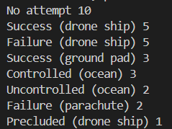
Rank Landing Outcomes Between 2010-06-04 and 2017-03-20
Rank the count of landing outcomes (such as Failure (drone ship) or Success (ground pad)) between the date 2010-06-04 and 2017-03-20, in descending order querie : SELECT Landing_Outcome, COUNT(*) AS Count FROM SPACEXTABLE WHERE Date BETWEEN '2010-06-04' AND '2017-03-20' GROUP BY Landing_Outcome ORDER BY Count DESC;
Result :

Slide 34

Section 3

Slide 35
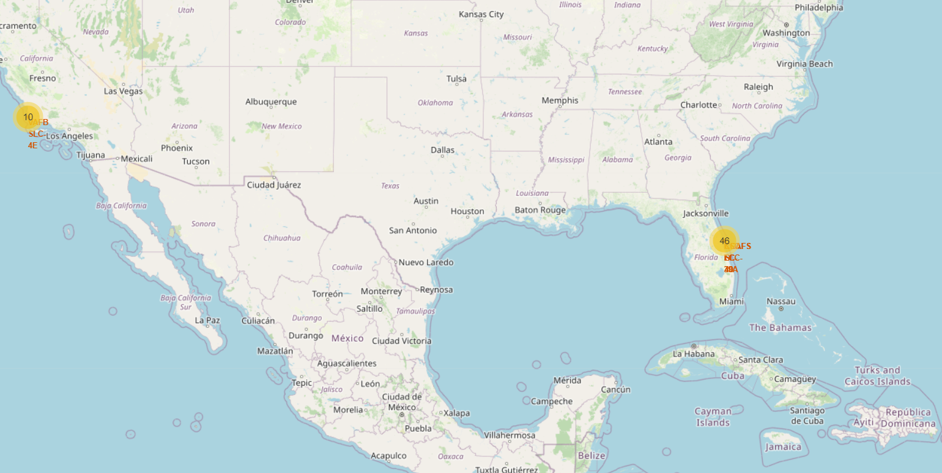
Launch site location analysis
10 launches on the west coast of the United States and 46 on the east coast.
It is important to install the site around the coast because of the test accidents.

Slide 36
<Folium Map Screenshot 2>
Replace <Folium map screenshot 2> title with an appropriate title
Explore the folium map and make a proper screenshot to show the color-labeled launch outcomes on the map
Explain the important elements and findings on the screenshot

Slide 37
<Folium Map Screenshot 3>
Replace <Folium map screenshot 3> title with an appropriate title
Explore the generated folium map and show the screenshot of a selected launch site to its proximities such as railway, highway, coastline, with distance calculated and displayed
Explain the important elements and findings on the screenshot

Slide 38

Section 4

Slide 39
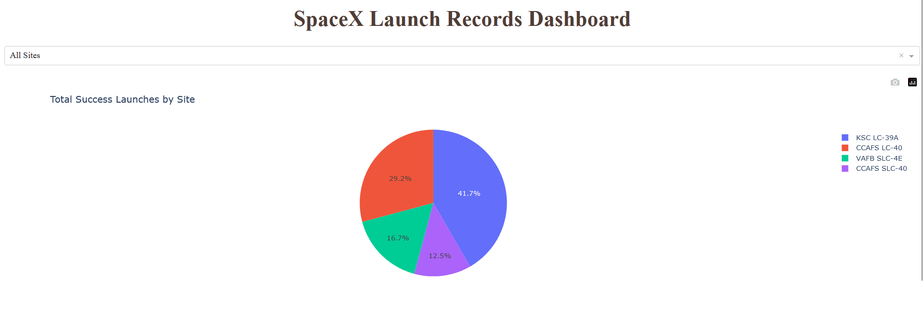
Proportion of success launches over site
KSC LC 39A is a good launch site unlike CCAFS-SLC-40

Slide 40
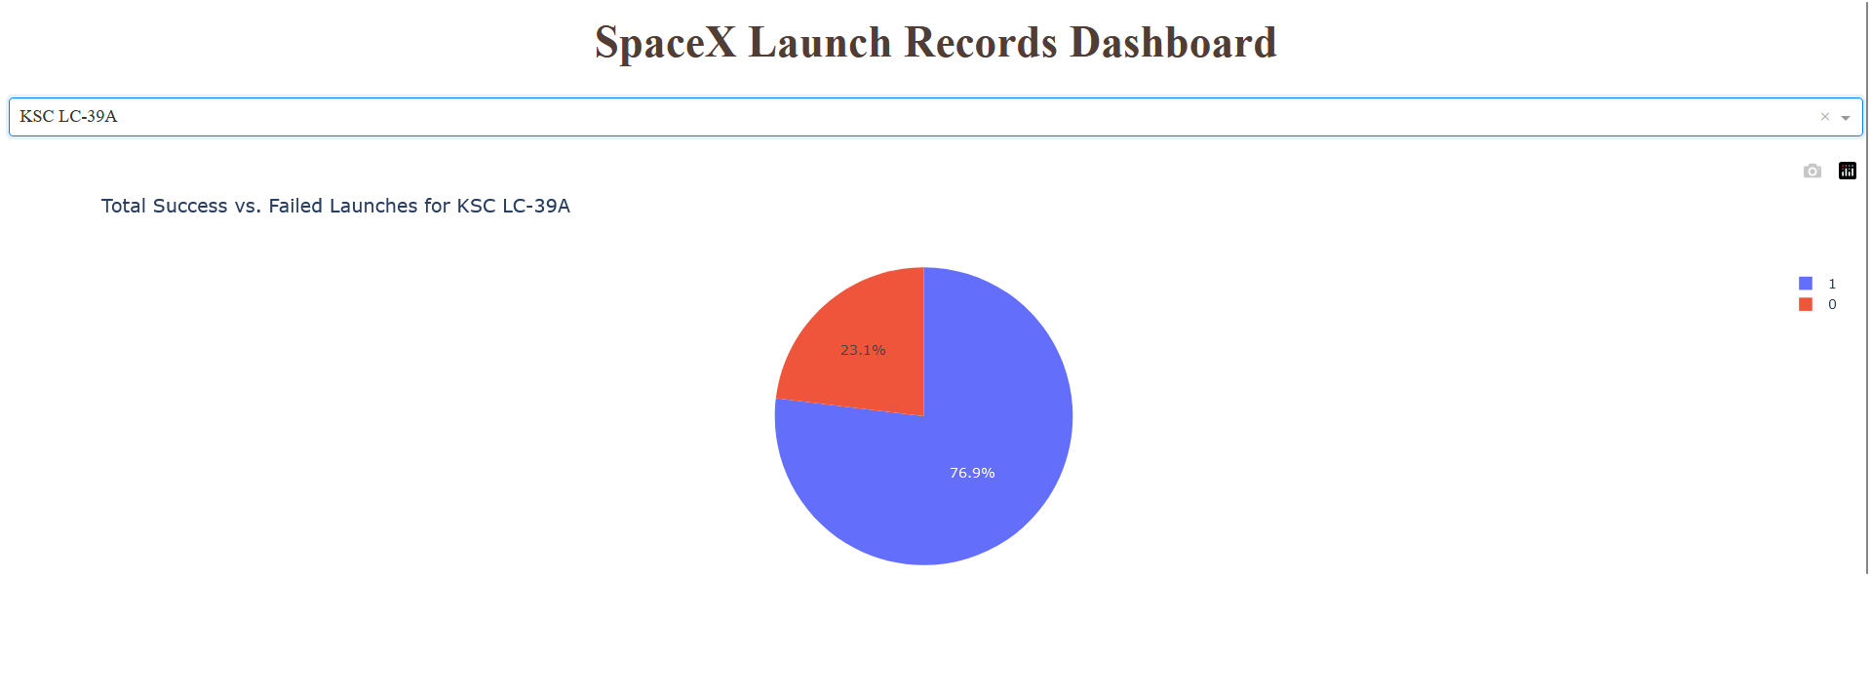
KSC LC-39A success and fail launch
Hight success rate.

Slide 41
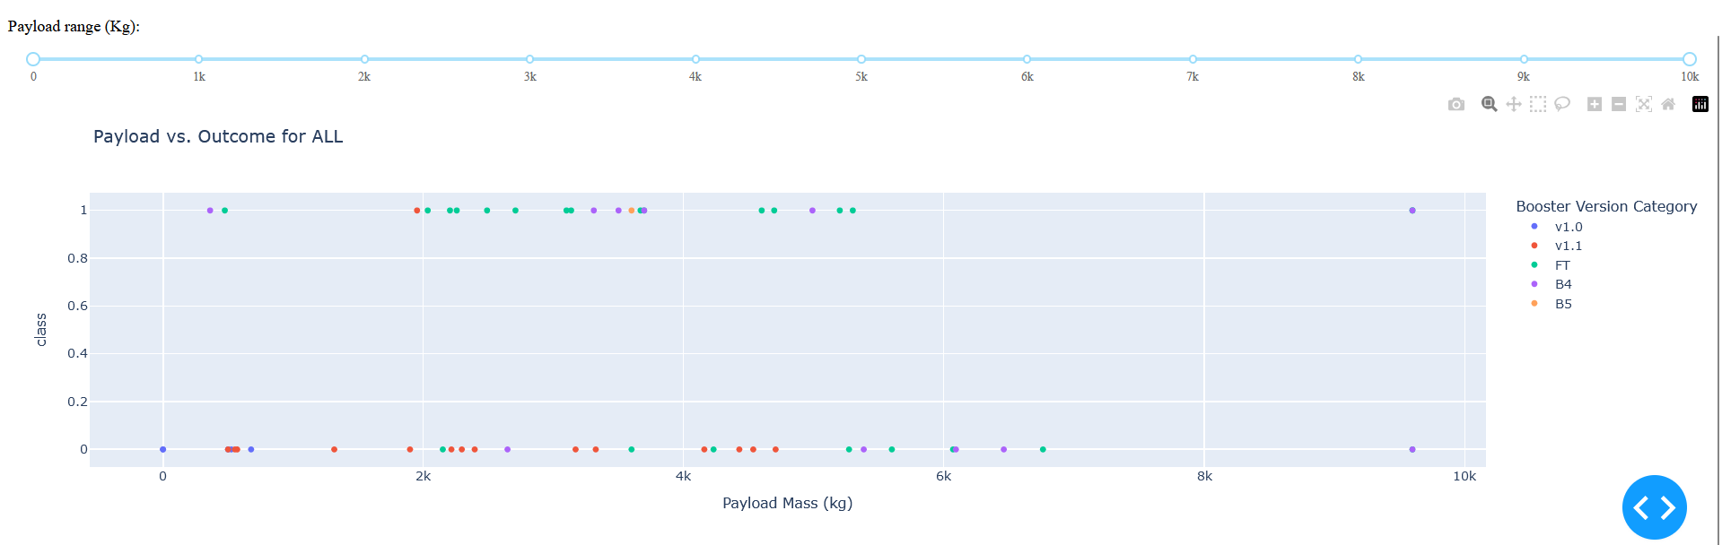
Scatter plot of Payload vs Launch Outcome for all sites
For the FT booster, payload mass between 2K and 4K gives us a success rate of 7/9, which is very decent, if we can determine the optimal mass for our payload, it will increase our positive result.

Slide 42

Section 5

Slide 43
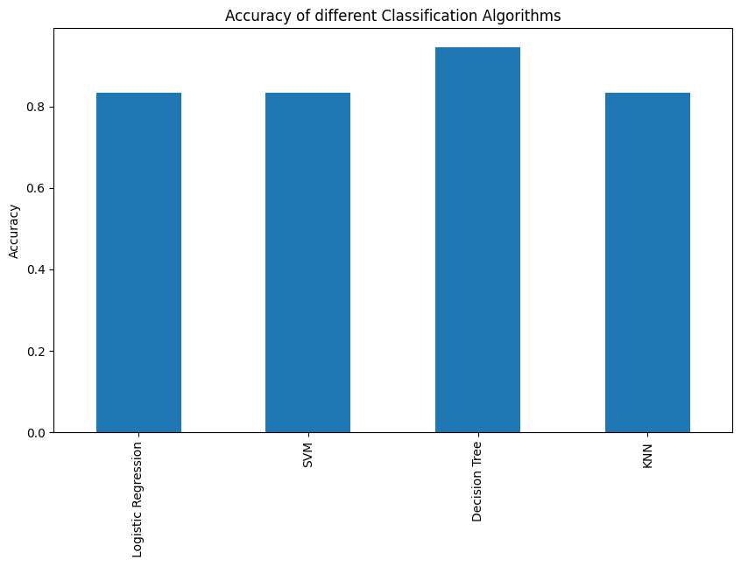
Classification Accuracy
Decision Tree's accuracy score is higher than other algorithms.

Slide 44

Confusion Matrix
5 False Negatif
1 False Positif
0 True Negatif
12 True Positif

Slide 45
Conclusions
Collecting data by the API of SpaceX
Filtering to get what we want
Cleaning the data
Explore the data to get some global idea on dependent variables
Develop some visualization tools to validate our conjecture
Use classification algorithm to answer our initial problem

Slide 46
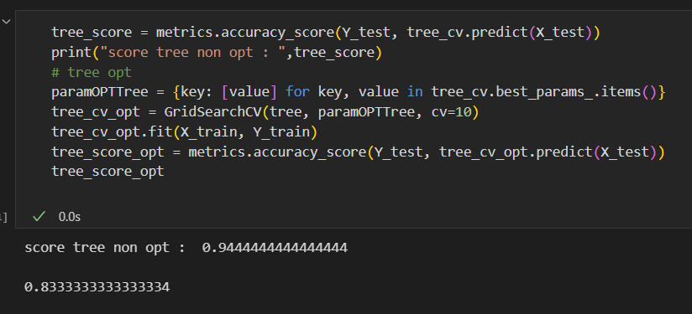
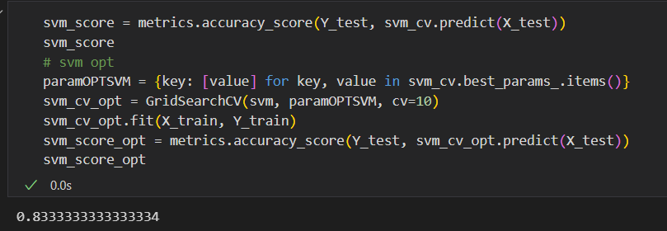
Appendix

Slide 47


